Slide 1
Get Started with RStudio

Slide 2
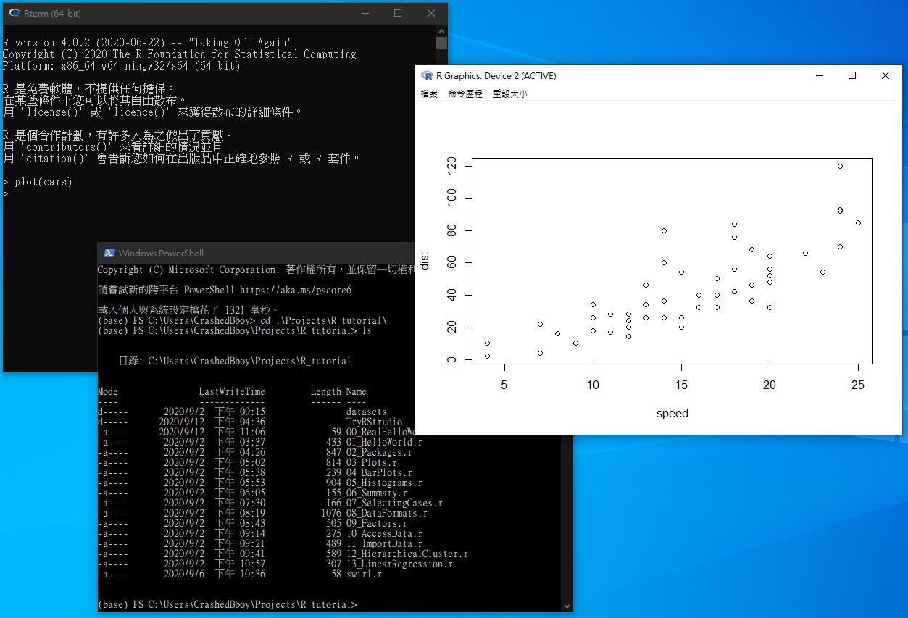
Why RStudio?
R Studio is an IDE (Integrated Development Environment), it provides everything you need during developing R programs.
A good IDE provides functionality of
code editor
code execution
execution result viewer
debugging
file management
dependency management
etc.
If you develop R programs without an IDE,
you have to integrate tools by your own

Slide 3
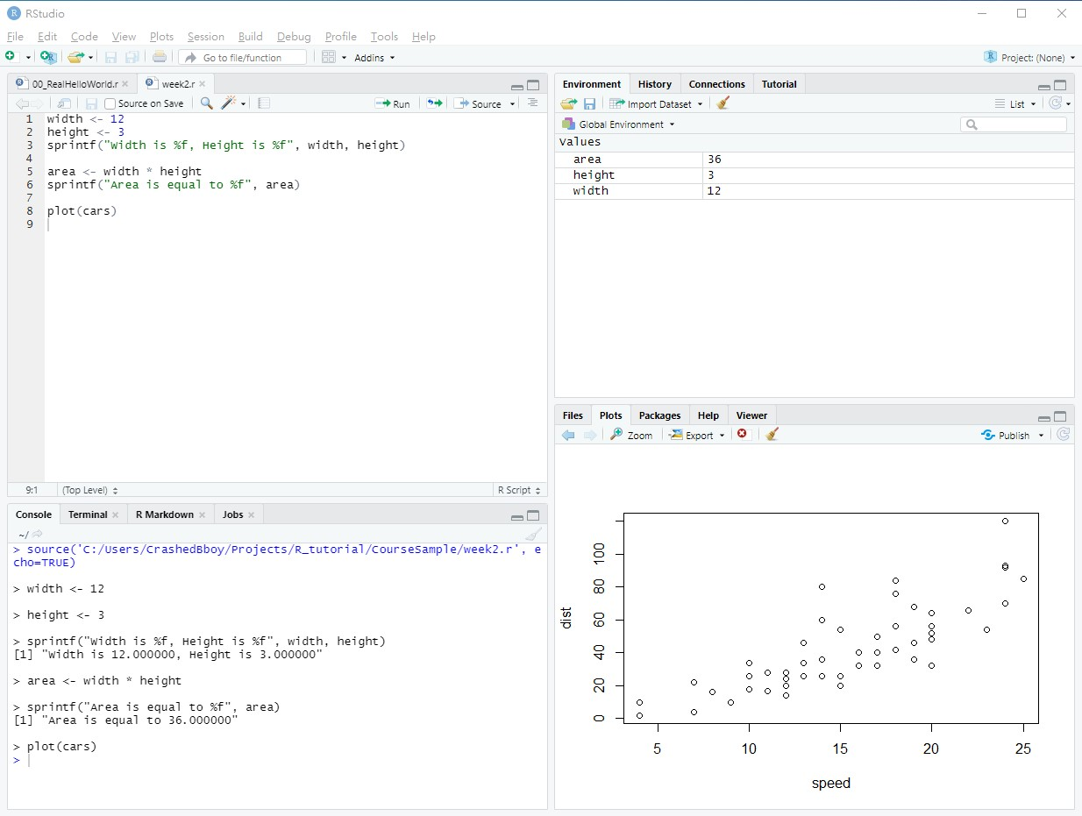
RStudio UI Overview

Slide 4
RStudio UI Overview
Editor
Place for programming R or writing document
(cont.)

Slide 5
RStudio UI Overview
Console
Interface to execute commands and view results, logs, error messages, etc.
(cont.)

Slide 6
RStudio UI Overview
Environment Information
List variable values, records previously executed code, show data connections
(cont.)

Slide 7
RStudio UI Overview
Other Useful Tools
Manage files, display plots & figures, list software packages, show user manual, …
(cont.)

Slide 8
Now Try Yourself: Hello World !
STEPS
create a new R script
write (paste) R program
run code
check variable value
check output of execution
check rendered plots

Slide 9
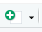
Now Try Yourself: Hello World !
STEP create a new R script
create new R script by click “new” button,
select “R Script”.
or you can do this in menu
“File -> New File -> R Script”

Slide 10
Now Try Yourself: Hello World !
STEP write (paste) R program
paste the following sample to your editor
greeting_string <- "Hello Text Analysis"
print(greeting_string)
plot(cars)

Slide 11

Now Try Yourself: Hello World !
STEP run code
select all of your code,
then click “run” button
or press Ctrl + Enter to execute code

Slide 12
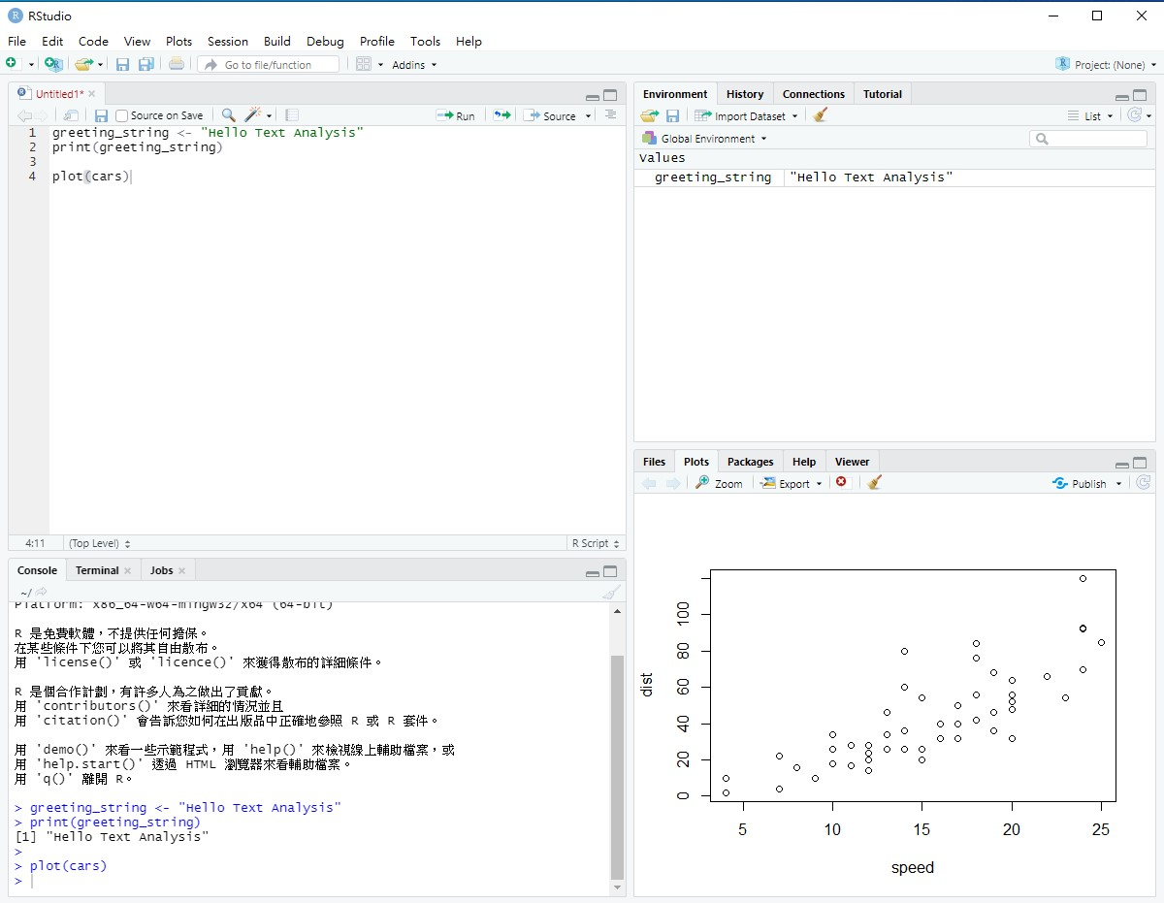
Now Try Yourself: Hello World !
STEP: check
variable values, in tab “Environment”
execution output, in tab “Console”
rendered plot, in tab “Plots”

